Slide 1

Mentor Automotive
connectivity | autonomous | electrification | architecture

Slide 2
MQTT
Message Queuing Telemetry Transport
Marco Residori, 6 Feb 2018

Slide 3
KEY facts
Machine-to-machine (M2M)/"Internet of Things" connectivity protocol [1]
Invented by Dr. Andy Stanford-Clark of IBM and Arlen Nipper of Arcom (now Eurotech) in 1999 [2]
OASIS (Organization for the Advancement of Structured Information Standards) standard [3]
ISO standard (ISO/IEC PRF 20922) [1] [6] [7]
Public and royalty-free license [2]
Used by Amazon Web Services, IBM WebSphere MQ, Microsoft Azure IoT, Adafruit, Facebook Messenger [2]

Slide 4
FEATUREs
Small code footprint
Ideal if processor or memory resources are limited
Ideal if bandwidth is low or network is unreliable
Publish/subscribe message exchange pattern
Works on top of TCP/IP
Quality of service: at most once, at least once, exactly once
Client libraries for Android, Arduino, C, C++, C#, Java, JavaScript, .NET [16]
Security: authentication using user name and password, encryption using SSL/TLS [2]
Persistence: MQTT has support for persistent messages stored on the broker. [12]
MQTT-SN (protocol for sensor network) works on non-TCP/IP networks (e.g. Zigbee) [17]
MQTT over websocket possible (browser as MQTT client) [14]
Request/response message exchange pattern as add-on[15]

Slide 5
Fields of application
Home automation (e.g. lightening, smart meter)
Healthcare
Mobile phone apps (e.g. messaging, monitoring)
Industrial automation
Automotive
IoT applications in general

Slide 6
Publish/subscribe
Multiple clients connect to a broker and subscribe to topics that they are interested in.
Clients connect to the broker and publish messages to topics.
Topics are treated as a hierarchy, using a slash (/) as a separator.
Example: multiple computers may all publish their hard drive temperature information
on the following topic, with their own computer and hard drive name being replaced as appropriate:
sensors/COMPUTER_NAME/temperature/HARDDRIVE_NAME
Clients can receive messages by creating subscriptions. A subscription may be to an explicit topic,
in which case only messages to that topic will be received, or it may include wildcards.
Two wildcards are available, + or #. [10]
MQTT clients can register a custom ‘last will testament’ message to be sent by the broker if they disconnect.
This message can be used to signal to subscribers when a device disconnects. [12]

Slide 7
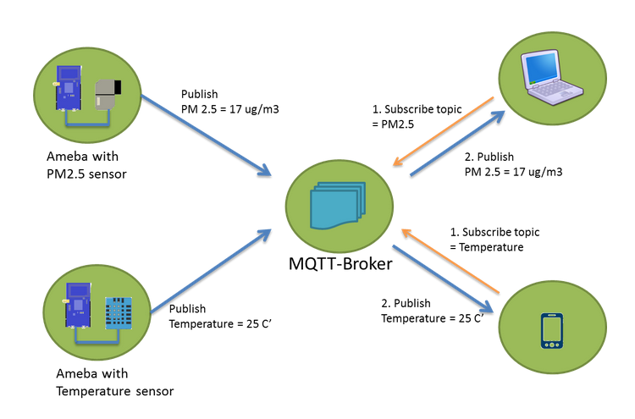
Publish/subscribe
mqtt publish/subscribe (source: [4])

Slide 8
Request/response
A request/response message exchange pattern can be implemented on top of MQTT. The following example shows how:
1) Client
- subscribe topic "function-xyz/response/<id>" //note: <id> is a client unique ID
2) Server
- subscribe topic "function-xyz/request/+" //note: "+" is a wildcard
3) Client
- publish topic "function-xyz/request/<id>" payload <input parameter>
4) Server
- receive notification "function-xyz/request/<id>" payload <input parameter>
- retrieve <id> from string
- process function-xyz(<input parameter>)
- publish topic "function-xyz/response/<id> " payload "<response>"
5) Client
- receive notification "function-xyz/response/<id>" payload "<response>"

Slide 9
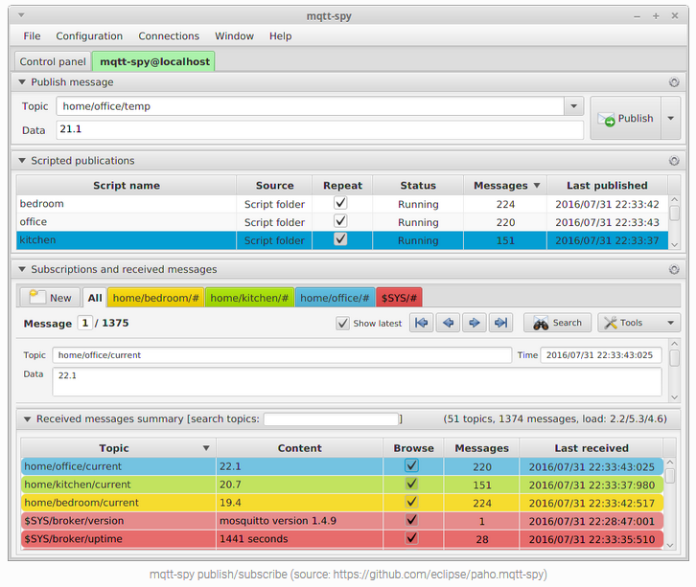
Client tools

Slide 10
brokerS [8]
HiveMQ
ActiveMQ
RabbitMQ
Mosquitto
flespi
IBM MessageSight
Mosca & Aedes
MQTT Dashboard
Eclipse IoT
VerneMQ
Solace
CloudMQTT
emqttd
Wave
vertx-mqtt-broker
JoramMQ
Moquette MQTT

Slide 11

Example
mosquitto is an open source (EPL/EDL licensed) message broker that implements the MQTT protocol versions 3.1. [5]
Server
Client

Slide 12

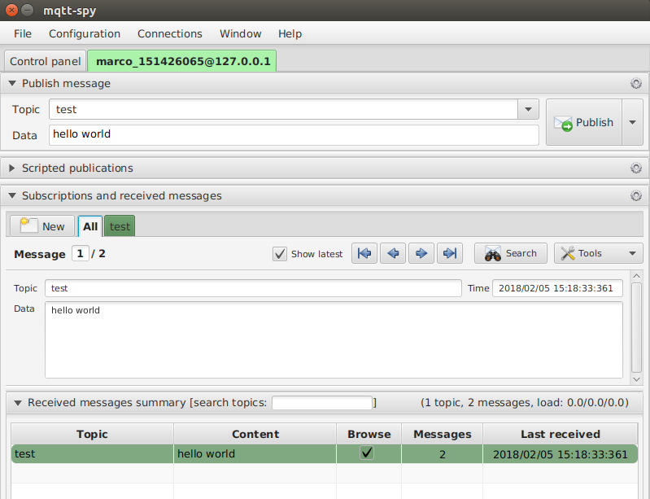
Example
mqtt-spy is an open source utility to monitor activity on MQTT topics. [11]
Server
Client

Slide 13
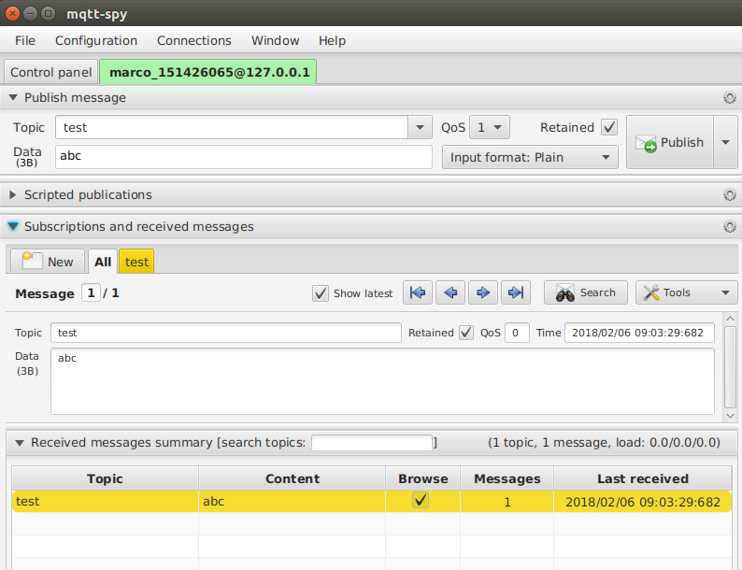
Example

Slide 14
Benchmarks
The scalability of a server with the number of clients is a critical factor to consider when a MQTT broker
is selected.
The mosquitto MQTT broker can handle up to 60000 publishers (connections) per second
with a latency varying from 10ms to about 1s (QoS = „at least once“, payload 64 Bytes, CPU load (1 core) 100%). See [13] for more details.
libmosquitto (client library) is about 1.3 MB.

Slide 15
References
MQTT. Web page. Retrieved from http://mqtt.org/
MQTT FAQ. Web page. Retrieved from http://mqtt.org/faq
MQTT. Web page. Retrieved from https://en.wikipedia.org/wiki/MQTT
4. Publish/susbscribe pattern. Digital image. Retrieved from https://www.amebaiot.com/en/ameba-arduino-mqtt-upload-listen/
5. Mosquitto. Web page. Retrieved from https://mosquitto.org/
6. MQ Telemetry Transport (MQTT) V3.1 Protocol Specification. Web page. Retrieved from https://www.ibm.com/developerworks/webservices/library/ws-mqtt/
7. MQTT V3.1 Protocol Specification. Web page. Retrieved from http://public.dhe.ibm.com/software/dw/webservices/ws-mqtt/mqtt-v3r1.html
8. Brokers. Web page. Retrieved from https://github.com/mqtt/mqtt.github.io/wiki/brokers
9. MQTT wiki. Web page. Retrieved from https://github.com/mqtt/mqtt.github.io/wiki
10. MQTT manpage. Web page. Retrieved from https://mosquitto.org/man/mqtt-7.html
11. mqtt-spy. Web page. Retrieved from https://kamilfb.github.io/mqtt-spy/
12 MQTT and CoAP, IoT Protocols. Web page. Retrieved from http://www.eclipse.org/community/eclipse_newsletter/2014/february/article2.php
13. Benchmark of MQTT servers. PDF document. Retrieved from http://www.scalagent.com/IMG/pdf/Benchmark_MQTT_servers-v1-1.pdf
14 MQTT over Websockets with HiveMQ. Web page. Retrieved from https://www.hivemq.com/blog/mqtt-over-websockets-with-hivemq
15. mqtt-rpc. Web page. Retrieved from https://www.npmjs.com/package/mqtt-rpc
16. Libraries. Web page. Retrieved from https://github.com/mqtt/mqtt.github.io/wiki/libraries
17. MQTT For Sensor Networks. PDF document. Retrieved from http://mqtt.org/new/wp-content/uploads/2009/06/MQTT-SN_spec_v1.2.pdf

Slide 16




Mentor Automotive
connectivity | autonomous | electrification | architecture

